Slide 1
Introduction to R
Notes:
Show of hands for who has never used R before
Who has used R basic
#ask questions and can comment on the pace as we go
#first session may be a bit easy for some but will level out as the course goes and is always a good refresher

Slide 2


What is R?
R is a computer programming language
It is a way of communicating with a computer
R was developed for and by statisticians, therefore very good for plotting + analysing data
I would like to plot a bar graph from my ELISA data
Je voudrais tracer un diagramme à bandes de mes données ELISA
Notes:
Other languages do the same thing, they just have different syntax so python is a bit more of a broader language but it can generally do most of the same things it just communicates with the computer differently

Slide 3

What makes up R
Functions e.g plotting graphs, joining tables, sorting data
Data frames – this is your data set
Objects – things you create, e.g a bar graph a data frame, a list
Operators – includes symbols we use to assign objects <- or =
I would like to plot a bar graph from my ELISA data and save it as a new graph
new_graph <- ggplot(data = ELISA_data aes (x=Sample_ID, y=Conc)) + geom_bar()
Notes:
Go into more detail later how to assign these things in R?
Read from ggplot
Everyone writes code differently as you can see you need to know what to save your object as at the start of the code. I normally write and test out my code and then go back to save it

Slide 4
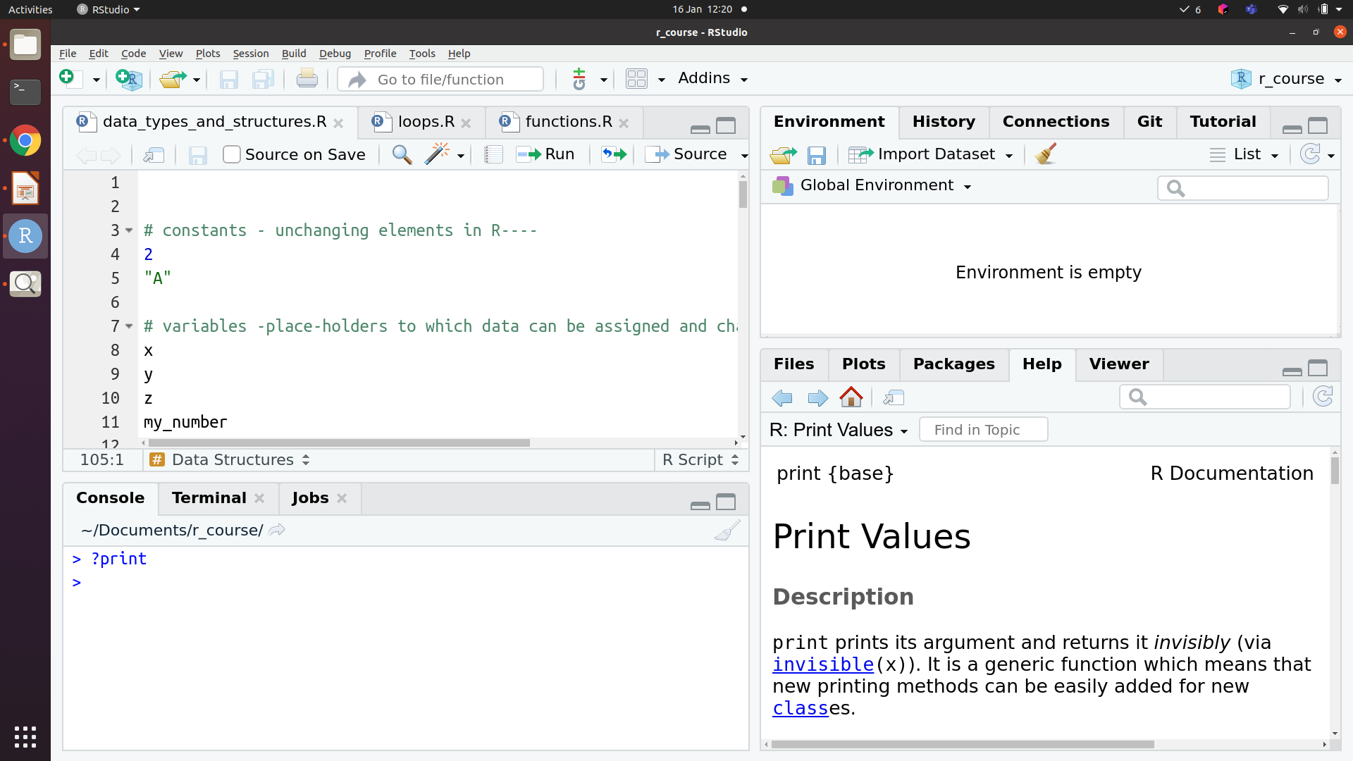




Your R (Rstudio) environment
Script
Environment / History
Help / Plots /
Files
Console
Script
Console
Help/Plots/Files
Environment/History
Notes:
When in R to r in the script ctrl + Enter or cmd Enter Mac to run line of code
In console you can run things directly by pressing enter

Slide 5

Let’s explore
Open R studio and set your working directory
Open the R script as well as the .csv file
Notice how the .csv file is arranged
Use ?before function/package to get more info + help
Notes:
Good habit to get into

Slide 6
Types of data in R
Character “a”, “apple”
Numeric 1, 23, 3.14
Logical TRUE, FALSE (also 1, 0 or T, F)
Factor For categorical variables, when data is classified into groups
Notes:
It’s important to understand the type of data you’re working with in R as this will often be necessary to streamline downstream processes such as manipulating or plotting your data, for example we need a time point saved as a factor (pre – post) but it often initially reads it as a character

Slide 7
Conversion (and coercion)
as.character()
Numeric, logical and factor types can be converted to character
as.numeric()
Logical, and character variables that are purely numbers can be converted to numeric
as.logical()
“FALSE” or 0 is converted to FALSE, “TRUE” or any non-zero number is converted to TRUE
as.factor()
Any other data type can be converted to a factor
Warnings
Warning message:
NAs introduced by coercion
Notes:
Make sure your categorical variables are saved as factors (needed for downstream analysis) often they are read as characters or numeric data

Slide 8
Let’s explore practically

Slide 9
Data Structures:
data.frame
Data organised into rows and columns; elements of each column are of the same type, but different columns can be of different types
1
2
3
4
1
2
3
matrix
All elements are of the same type, data organised in rows and columns (normally all numeric data)
1
2
3
4
1
2
3
atomic vector
All elements are of the same type. Different vector types e.g numeric, logical, character
1
2
3
4
1
2
3
4
1
2
3
4
“a”
“a”
“c”
“f”
1
2
1
4
T
F
T
T

Slide 10
Data Structures: list
list
Elements can be different types, elements can also be other data structures
1
2
3
4
1
2
3
1
2
3
4
1
2
3
4
1
1
2
3
4
1
list
T
F
T
T
“a”
“a”
“c”
“f”
2
2
3
3
Notes:
A data.frame is actually a type of list! (where each element of the list is an atomic vector of equal length)

Slide 11
Let’s explore practically

Slide 12
Subsetting R objects
[ ] – To get a subset of elements
[[ ]] – To get a specific element from a list (or a column of a data.frame)
$ - To subset a specific column in a data.frame

Slide 13
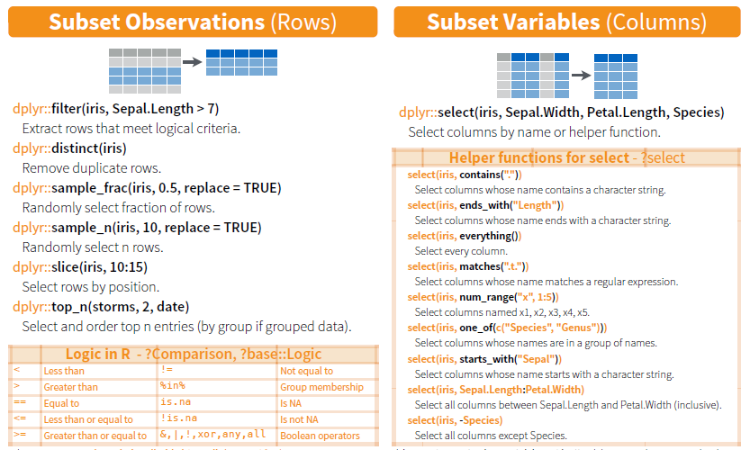
Subsetting using dplyr package
Iris is a data frame containing observations about different types of flowers

Slide 14
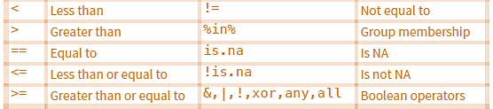
Filter in R
A useful function for example when you want to filter samples that meet a certain threshold or percent cv
Uses dplyr package and base R logic as filter criteria
!= (Negation of anything in R is done with !)
Notes:
Comparison between two objects returns TRUE or FALSE or NA

Slide 15
Let’s explore practically

Slide 16
Math operations
Add, subtract, divide, multiply
+ - / *
Modulo (remainder of division)
%%
Exponent
^
Rounding
round(), floor(), ceiling()

Slide 17
Vi Purification Experiment
Participant serum was incubated on a Vi (typhoid antigen) coated plate
After the incubation we measured the concentration of Vi in the supernatant using an ELISA – this is the Vi that we didn’t capture
The difference between pre purification and post purification (supernatant) concentrations is therefore the amount of Vi antibody that has been bound to the plate
ELISA on unbound antibody
Pre
Post
Notes:
The more Vi missing difference is the Vi bound to the plate, so the more vi that’s in the supernatant means poor binding

Slide 18
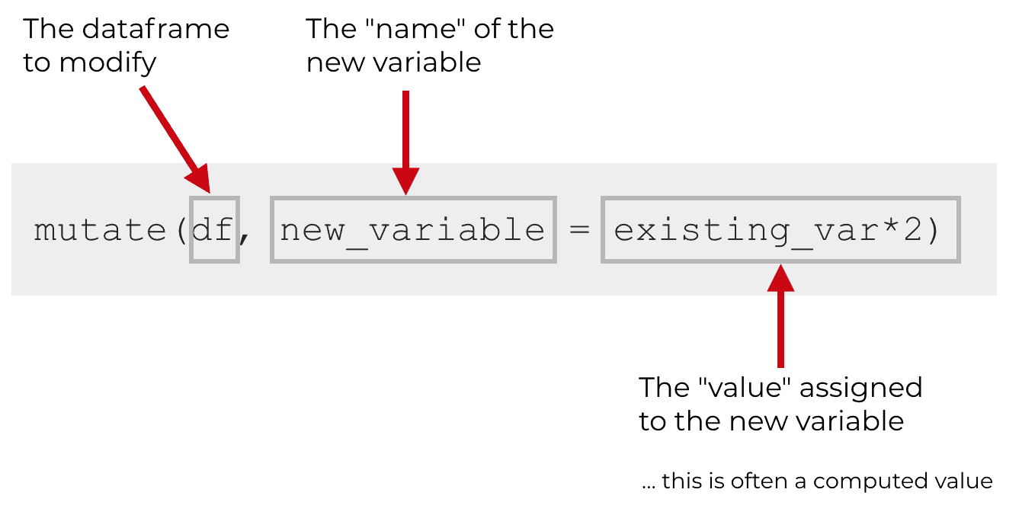
Mutate
When you use mutate(), you need typically to specify 3 things:
- the name of the dataframe you want to modify
- the name of the new variable that you’ll create
- the formula/value you will assign to the new variable

Slide 19
Let’s explore practically

Slide 20
Mutate with subsetting
Normally in excell we can just calculate across rows by selecting the cells we need
In R our data isn't formatted as such - this is one of the biggest things to get used to so don't worry if it's confusing at first!
We can instead use group_by function to ensure that data operations are done according to those with the same sample ID.
In addition to group_by, we also need to specify what condition we would like to use to perform the calculation.
For this we can use the subset operator [], along with base logic, so == to specify a condition

